Slide 1
Topic 03 The Role of IT in Managing Information
ICT292 Information
Systems Management

Slide 2
Topic Learning Outcomes
At the completion of this topic, you should be able to:
Explain how information technology supports the management of information in the various phases of the information lifecycle
Critically assess the business value of information technology in organisations
Describe the purpose of IT architectures in organisations

Slide 3
Unit Learning Outcomes
This topic contributes to the following Unit Learning Outcomes:
LO1: Demonstrate an understanding of the role of information in organisations, and how it is managed.
LO2: Explain and evaluate the organisational infrastructure and legal and ethical frameworks within which information systems management takes place.

Slide 4
Resources
Text: Chapters 3
In particular, you should ensure that you read the three Match Lighting scenarios

Slide 5
Lecture Outline
Information in Information Systems and Information Technology
Capture, Store & Retrieve Information with IT
Use Generate and Share Information using IT
Maintain, Archive, and Destroy Information with IT
Business Value of IT and IT Architectures

Slide 6
Information in Information Systems and Information Technology

Slide 7
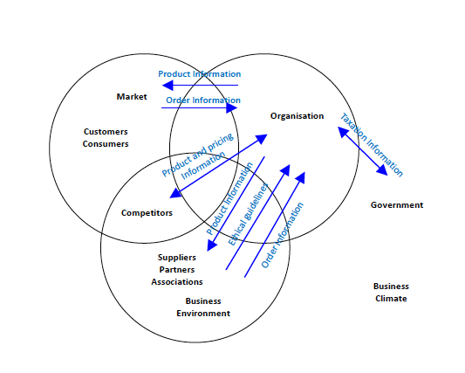
Information Flows

Slide 8
Types of Systems
Formal or informal.
Manual or computer-based.
Type of information processing.
Data processing, office automation, management information, decision support
Type of information technology.
Desk-top, web-based, mobile.
Impact on organization.
Mandatory change, infrastructure, transformation.

Slide 9
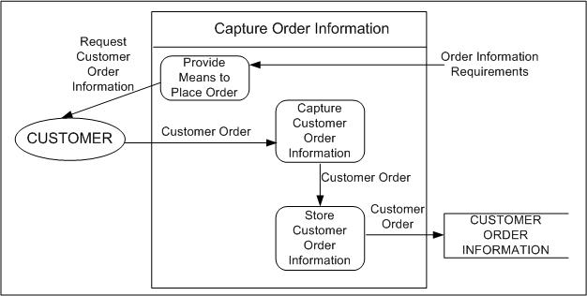
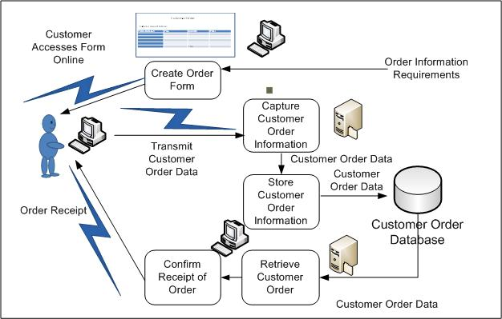
Implementing Information Systems
IT provides the means to implement the business processes.
IT devices support the data life cycle:
Capture data.
Transmit data.
Store and retrieve data.
Use and maintain data.
Archive and destroy data.
Figures 3.2 and 3.4

Slide 10
Capture, Store & Retrieve Information with IT

Slide 11
Elements of data capture
Type of data to be captured
Technical device to capture the data
Instructions relating to what data to capture, what form to capture the data in, and what to do with it once it has been captured, and
Method of transmitting the data to where the data are to be stored or used

Slide 12
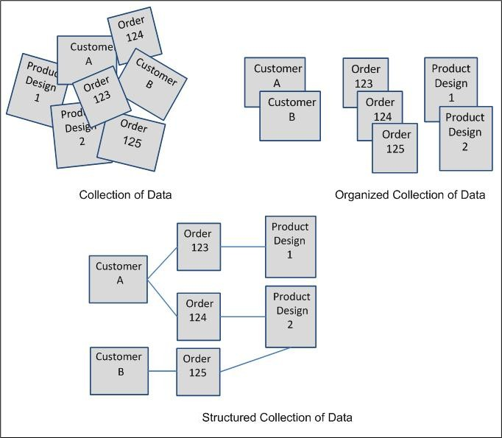
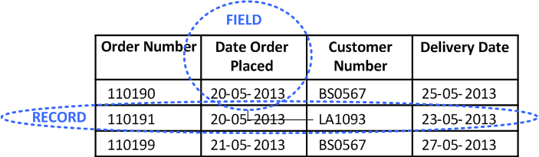
Database
Figures 3.9 and 3.10

Slide 13
Data Storage Device Considerations
Portability: Does the device need to be transported?
Capacity: How much data need to be stored?
Speed: How long does it take to find and retrieve the data stored?
Storage method: How are the data stored on the device (e.g. magnetic storage, solid state)?
Scalability: Can storage be increased?
Autonomy: Can the storage be replaced?
Fault tolerance: How resilient is the storage device?

Slide 14
Use Generate and Share Information using IT

Slide 15
IT Supports Information Characteristics
Timeliness, information retrieval.
Frequency of reporting.
Appropriateness, extracting specific attributes.
Accuracy, validation and verification controls.
Brevity, provide different views of data.
Rarity, set alerts and identify information, anomalies.
Understandability, customize reporting.
Action, transmit information to appropriate person.
Presentation, adapt to satisfy differing needs and preferences.

Slide 16
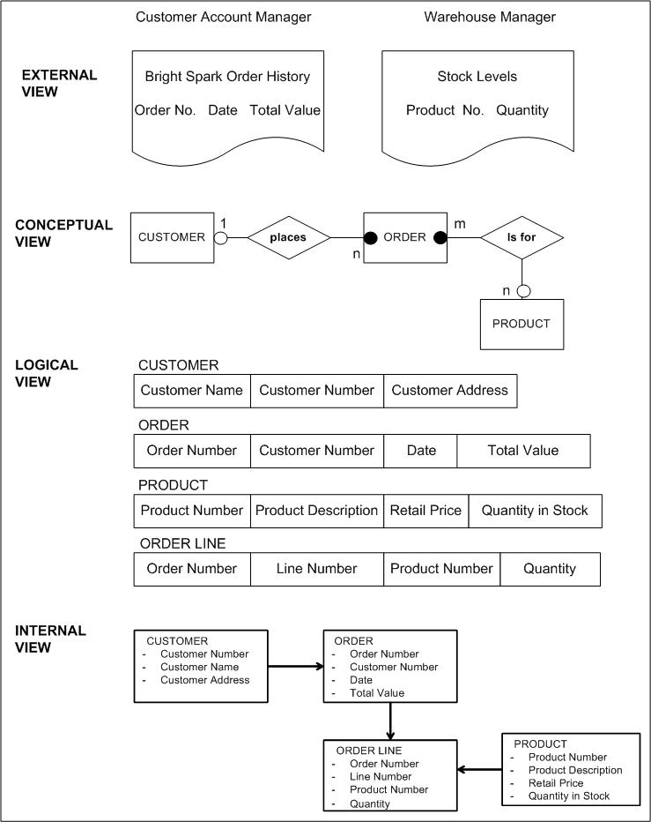
Views of a Database
External views of business processes.
Conceptual view to meet needs of all processes.
Logical view of how data is stored (schema).
Internal view of physical storage.
Access data without knowing how or where data are stored.
Physical storage can change.
Figure 3.11

Slide 17
Adding value to information
There are 5 ways in which value can be added to data:
Correction
Categorisation
Condensing
Calculation
Contextualisation

Slide 18
Maintain, Archive, and Destroy Information with IT

Slide 19
Maintaining information…
Keeping data accurate/safe/secure:
Providing access to allow people to perform their duties
Preventing unauthorised people from accessing or changing data
Preventing accidental changes or deletion
Restricting the changes that can be made through the use of validation
Keeping a copy of the data before changes are made in case the data need to be restored
Keeping an audit trail of the changes made to the data
Backing up…

Slide 20
Archiving, destroying data
Archiving allows for ordered data retention in such a way that the archived data can be retained and retrieved as necessary
Governed by policies…
Must still be able to read it!
Destroying data will happen once the required retention period has expired

Slide 21
Business Value of IT and IT Architectures

Slide 22
Benefits of Information Technology
IT improves the transmission speed, quality, and timely access to data.
The value of technology to the organization is reflected in:
Availability of information, of the appropriate quality, when needed.
More informed decisions.
Efficient operation of business processes.
Effective use of resources, including information, people, equipment and space.
Transformation of the organization architecture.

Slide 23
Strategic role of IT
IT can create and maintain competitive advantage
Reducing costs through efficiencies
Provision of information to support product innovation
Improved customer engagement
Identify profitable customers
Reduction of churn etc…

Slide 24
Information Technology Architecture
Defines the policies for the purchase, development, and implementation of hardware and software to integrate data in compatible IT systems.
Mobile Devices Desktop | Applications | Servers Processors Storage Media Printers | Operating Systems Database Management Systems | Local Area Network Wide Area Network Security | Protocols | Offsite Data Archive
Policies Standards Guidelines
IT infrastructure represents the organization of IT devices to implement information systems.
Figure 3.18

Slide 25
Relationship Between Strategies
Organization strategy:
Why information is needed.
Information systems strategy:
What information and what information processes are needed to meet the information needs of the organization.
Information technology strategy:
How the information needs of the organization be met.

Slide 26
Summary

Slide 27
Topic Learning Outcomes
At the completion of this topic, you should be able to:
Explain how information technology supports the management of information in the various phases of the information lifecycle
Critically assess the business value of information technology in organisations
Describe the purpose of IT architectures in organisations

Slide 28
Next topic…
The Role of Business in Information Management
At the completion of this topic, you will be able to:
Apply a socio-technical approach to developing an information architecture
Identify information requirements using a range of business models
Understand the role of, and how to elicit, business rules
Describe an enterprise architecture

